Slide 1
Lesson objective
Title: Represented data
Aim:
Assign probability using Venn diagrams and two-way tables
Describe and state complimentary events
Plan:
Review expected outcomes
Complimentary events
Two-way tables and Venn Diagrams

Slide 2
Expected outcomes
Expected number of occurrences = $probability × number of trials$
A bag contains yellow, red and blue marbles. 1 marble was taken out and the colour recorded and then replaced. This happened 100 times and the results are in the table below.
What is the experimental probability of each colour?
If we did 350 trials, how many blue would we expect?
 | RED | YELLOW | BLUE | Total
Frequency | 25 | 42 | 33 | 100

Slide 3
Whiteboards
Sally counted the cars that drove past the school during the day. She counted 200 cars and the results are below.
What is the experimental probability that the next car will be yellow?
If Sally counted 800 cars, how many would she expect to be black?
 | RED | WHITE | YELLOW | BLACK | Total
Frequency | 50 | 42 | 60 | 48 | 200

Slide 4

Complimentary events
Are Mutually exclusive
This means that one event will occur OR the other will
E.g., normal die:
P(4) = $\frac{1}{6}$
P(not 4) $\frac{5}{6}$

Slide 5
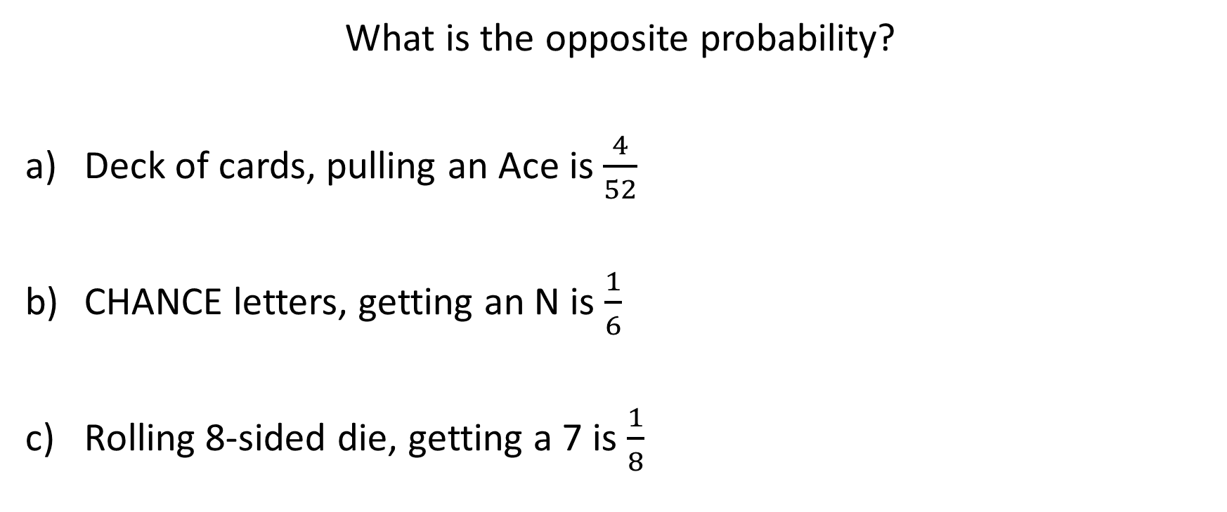
What are the complimentary events?
What is the opposite probability?
Deck of cards, pulling an Ace is $\frac{4}{52}$
CHANCE letters, getting an N is $\frac{1}{6}$
Rolling 8-sided die, getting a 7 is $\frac{1}{8}$

Slide 6
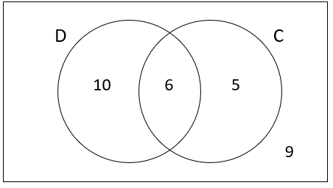
C grade questions
Rolling a 12 sided die and getting a 7, what is the complimentary event?
P(popcorn or choc)
P(popcorn or choc but not both)
P(had neither)
 | Chocolate | Not choc | Total
Popcorn | 11 | 15 | 26
Not pop corn | 9 | 5 | 14
Total | 20 | 20 | 40
Owns a Dog or Cat or both
P(only dog)
P(Cat or dog)
P(not dog)

Slide 7

Sketch into exercise book
U =
 | Surfing
Skate
Surfing
Skate
21
9
15
6

Slide 8
Two-way tables
 | Own car | Don’t own car | Total
Own home | 8 | 2 | 10
Don’t own home | 17 | 13 | 30
Total | 25 | 15 | 40
Convert into a Venn Diagram
THEN,
Find the probability of:
What is the probability that a person who owns a car also owns a house?
P(owns neither)
P(own only their car)

Slide 9
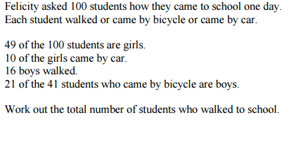
Creating 2 way-tables
Read info
Pick categories
Set table
Fill in what we know
Create a two-way table

Slide 10
Whiteboards
45 people were asked about the types of pets they have.
25 said they had a dog.
21 said they had a cat.
15 said they had both.
Draw a Venn diagram
What is the probability of selecting someone with just a cat?
P(some one who has a cat and a dog)
P(someone who does not have a dog)
Given this person has a dog, P(they have a cat too)
$$\frac{6}{45}$$
$$\frac{15}{45}$$
$$\frac{20}{45}$$
$$\frac{15}{25}$$

Slide 11
Whiteboards
100 people were asked if they eat KFC or Maccas.
45 people said they eat KFC
50 people said they eat Maccas
27 people said they eat both.
Create a Venn diagram.
P(someone who only eats KFC)
P(Eats neither)
P(Doesn’t eat KFC)
Given they eat Maccas, P(they eat KFC too)
$$\frac{18}{100}$$
$$\frac{32}{100}$$
$$\frac{55}{100}$$
$$\frac{27}{100}$$

Slide 12
Language of probability!
U = 100
A person selected at random, find the probability that they:
P(owned 1 animal)
P(owned at least 2)
P(owned cat or horse)
P(owned cow or cat but not both)
P(did not have these animals)
Owes a cat
Owns a horse
12
21
9
4
9
11
35/100
45/100
66/100
58/100
20/100
14
20
Owns a cow

Slide 13




Example
A vet surveys 100 of her clients. She finds that:
25 own dogs 15 own cats and dogs 11 own dogs and tropical fish
53 own cats 10 own cats and tropical fish 7 own dogs, cats and tropical fish
40 own tropical fish
A client is chosen at random, find the probability that the client:
a) Owns dogs only.
b) Does not own tropical fish.
c) Does not own dogs, cats or tropical fish.
11 – 7 = 4
25-(8+7+4)=6
15 – 7 = 8
53-(8+7+3)=35
40–(4+7+3)= 26
10 – 7 = 3
$$ξ$$
D
C
Don’t forget to complete the full set:
6+8+35+4+7+3+26 = 89
100 – 89 = 11
8
6
35
7
4
3
26
F
11

Slide 14
Whiteboards: have a go
70 people were asked where they had travelled this year.
18 people said they went to Busselton and Bali
19 people said they wen to Perth and Busselton
11 people said they had been to Busselton, Perth and Bali.
20 people went to Perth and bali
A total of 37 people have been to Bali.
13 people only went to Perth
Everyone had been to at least 1 place.
U = 70
Buss
Bali
Perth

